Slide 1
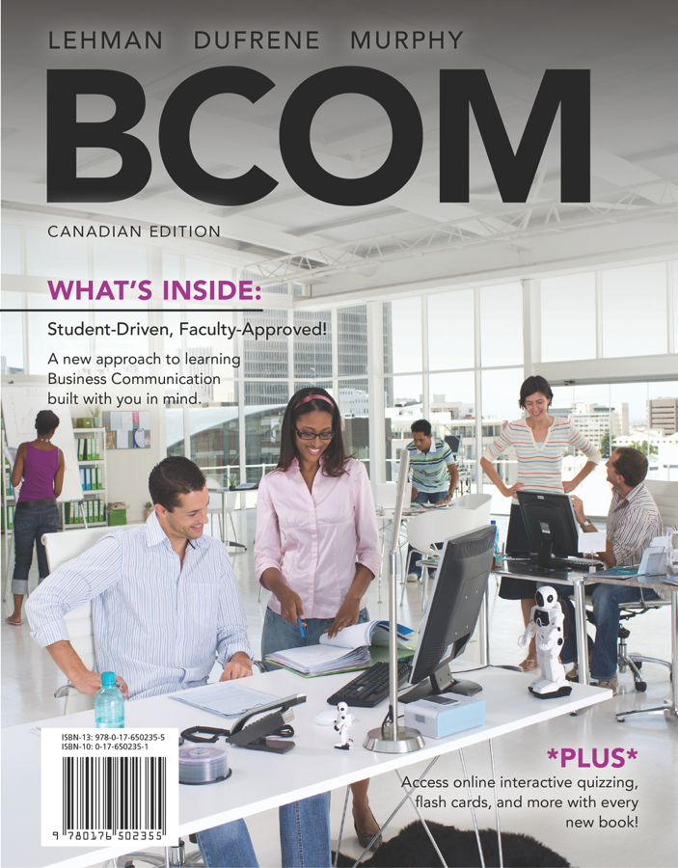
NETA PowerPoint® Slides
to accompany

Slide 2
Preparing Employment Messages

Slide 3
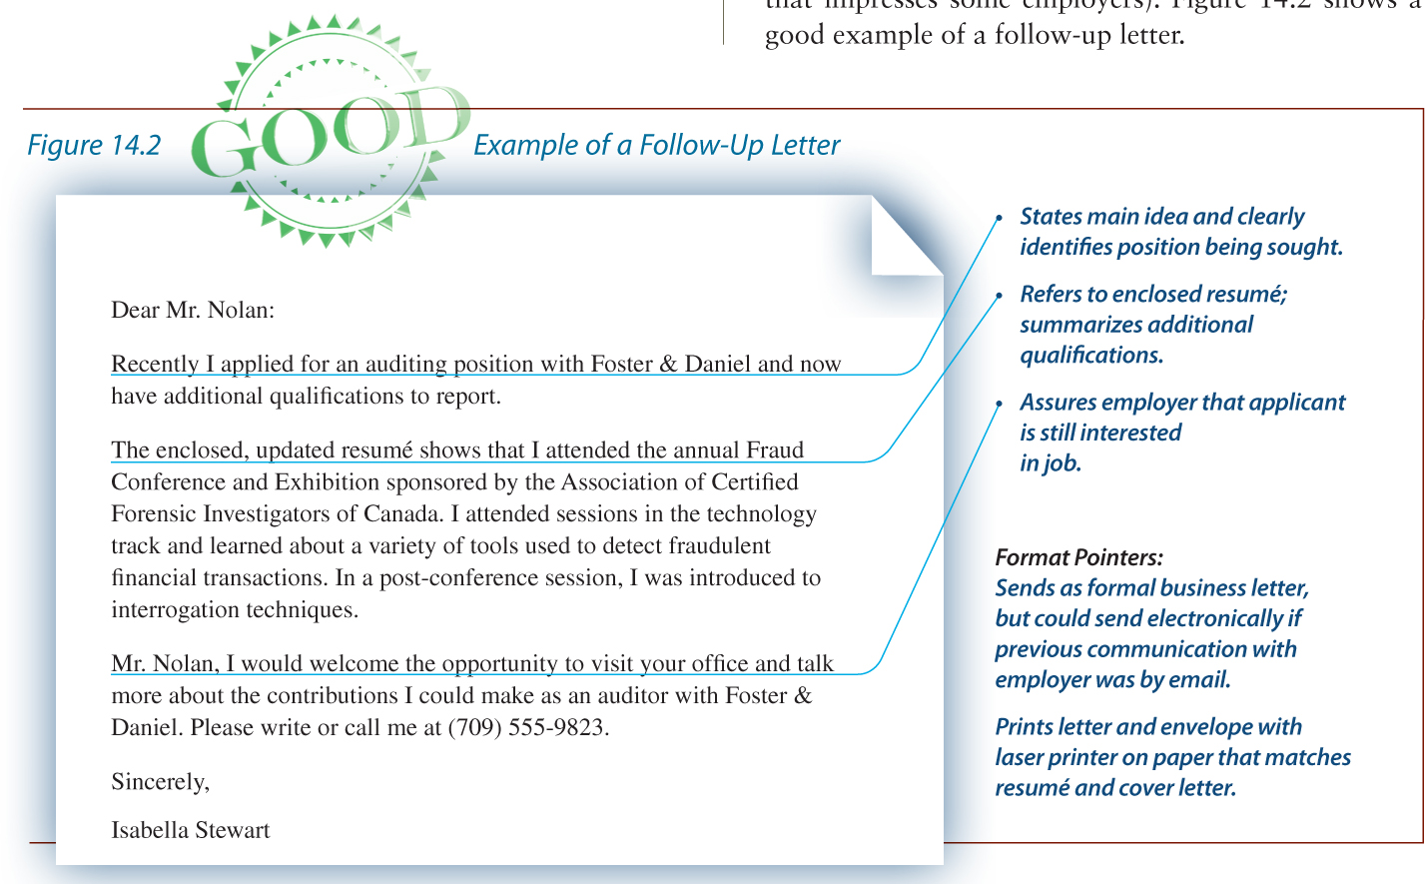
Good Example of a Follow-up Letter
Notes:
When you don’t receive a reply to your cover letter and resumé, you can wait a few weeks and send a follow-up message. Include a reminder about your application being on file and add any education or work experience that you’ve acquired in the intervening time and how it relates to the job. Close with asking for a desired action.
Review the sample letter on the slide for all of these components.
Follow-up messages also indicate persistence (a quality that impresses some employers).

Slide 4
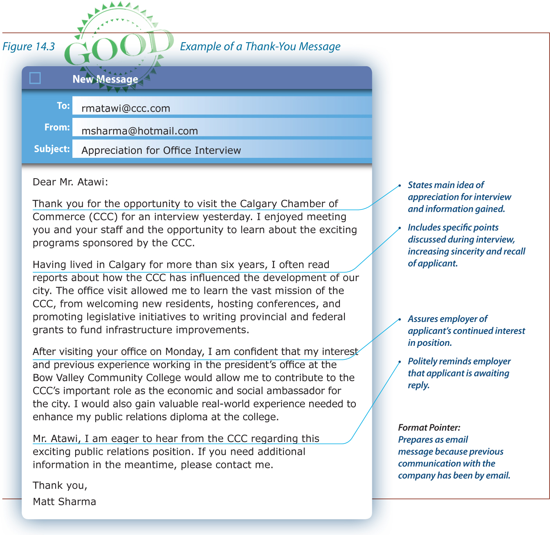
Good Example of a Thank-you Letter
Notes:
After a job interview, a thank-you message is a professional courtesy and enhances your image within an organization.
For maximum impact, send a thank-you message the day of the interview.
Even if during the interview you decided you do not want the job or you and the interviewer mutually agreed that the job is not for you, a thank-you message is appropriate. It may open the door to your resumé being passed along to another department that better matches your skills.

Slide 5
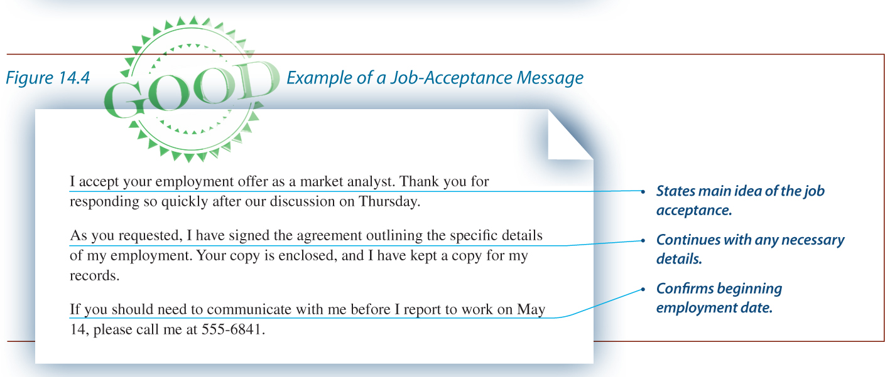
Good Example of a Job-acceptance Letter
Notes:
A job offer may be extended either by phone or in writing.
If a job offer is extended over the phone, ask for a written confirmation of the job
The offer should include the job title, salary, benefits, starting date, and anything else negotiated.
Often, companies require a written acceptance of a job offer. The above example show a job-acceptance message written in the direct pattern.

Slide 6
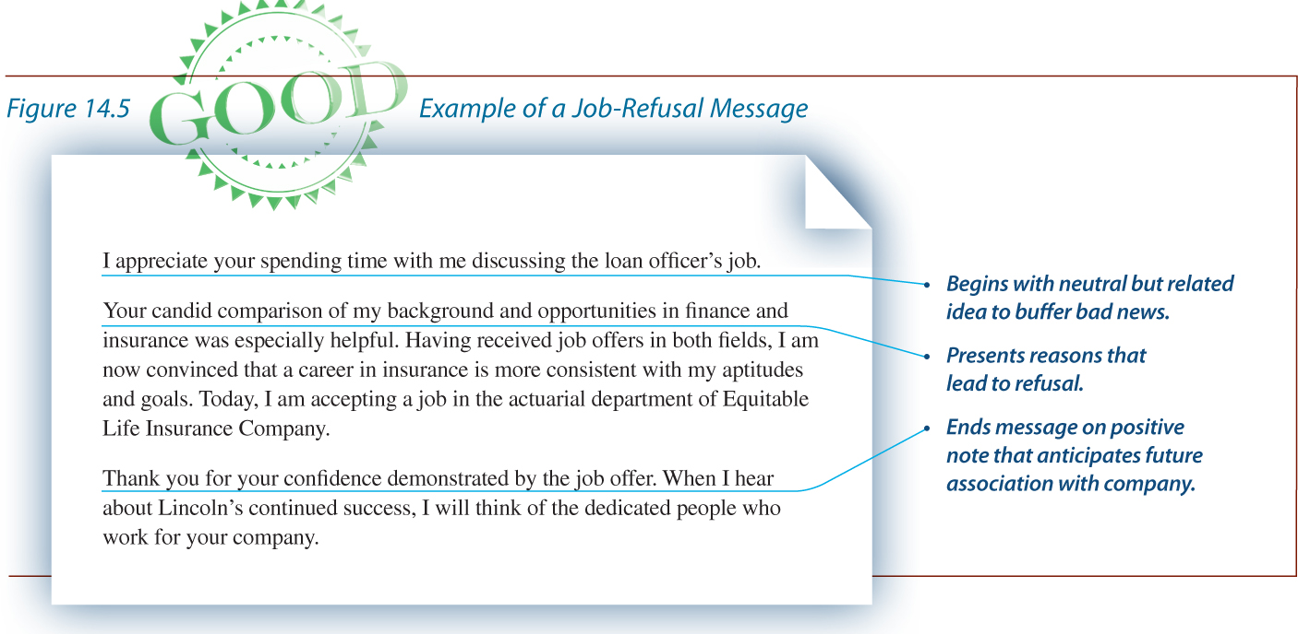
Good Example of a Job-refusal Letter
Notes:
Job refusal messages are written indirectly—with a beginning that reveals the nature of the subject, explanations that lead to a refusal, the refusal, and a pleasant ending.
Sometimes you don’t want to be specific about why you are turning down the job. Ask students what reasons they might have for turning down a job that they don’t want to explain to the person who interviewed them.
The text offers this solution for turning down a job without giving reasons.
After thoughtfully considering job offers received this week, I have decided to accept a job in the actuarial department of an insurance company.
You might want to be more specific about your reasons for refusal when you have a positive attitude toward the company or believe you will want to reapply at some later date. The letter in the slide includes the reasons for refusal.

Slide 7
Guidelines for References
Make sure that your references are prepared for your employer’s call or before an interview
Send them a recent résumé to help them deliver an on-target message
Send them an original thank-you note after you have accepted the job
Notes:
Companies seek information from references at various stages of the job search process. Some prefer talking with references prior to an interview, and others after a successful interview. Some prefer written recommendations from your references.
Specific actions on your part that are listed on this slide will ensure that your references are treated with common courtesy and that references are prepared for the employer’s call.
A sample of an appropriate thank-you note is on the following slide.

Slide 8
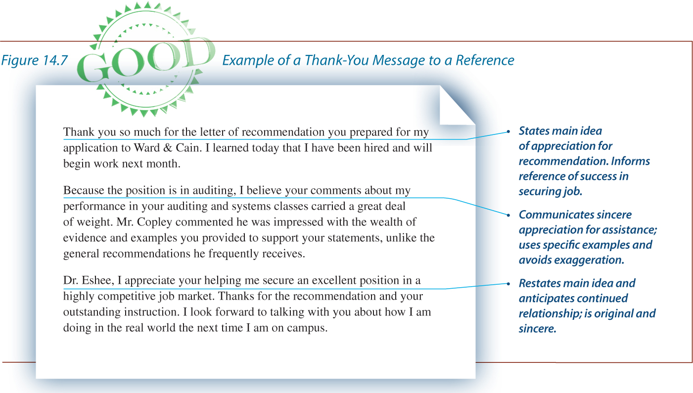
Good Example of a Thank-you Message
to a Reference

